Slide 1
IBM Data Science Capstone
Where Should You live?

Slide 2
Introduction
Everyone in the world needs to move at some point for better education, for better career opportunities or for just a better life. How does one make that decision? This project will look at two of the most happening cities in the world Toronto and New York.
Toronto is the thriving city in Canada that attracts a lot of people every year and New York City is the tourist center that attracts thousands of people each year.

Slide 3
Business Problem
The aim of this project is to help people choose where they should move to depending on lifestyle and experiences.
What neighbourhoods in the cities offer what they want to have. This also helps people make decisions if they are thinking about migrating to Toronto or New York or even if they want to relocate neighbourhoods within the city.
Our findings will help stakeholders make informed decisions and address any concerns they have including the different kinds of cuisines, provision stores and what the city has to offer.

Slide 4
Data Presentation
In order to look at the different cities we need geographical location data. Postal codes in each city will be the starting point. Using these postal codes, we will be able to find out our neighbourhoods, borough, venues, popular venues.
Toronto
We will need to scrape data from the following site: https://en.wikipedia.org/wiki/List_of_postal_codes_of_Canada:_M
This Wikipedia page has information about all the neighbourhoods; we limit it to London.
Neighbourhood: Name of Neighbourhood
Borough: Name of the borough
Postal code: Postal codes for London.
This Wikipedia page lacks information about geographical locations. To solve this problem, we use data from: https://cocl.us/Geospatial_data

Slide 5
Data Presentation
New York City
We will need to get our data from the following: https://cf-courses-data.s3.us.cloud-object-storage.appdomain.cloud/IBMDeveloperSkillsNetwork-DS0701EN-SkillsNetwork/labs/newyork_data.json
The JSON file has data about all the neighbourhoods in New York.
Neighbourhood: Name of Neighbourhood
Borough: Name of the borough
Latitude: Geographical location
Longitude: Geographical location

Slide 6
Data Presentation
Foursquare API Data
We will need data about different venues in different neighbourhoods. To get this information we will use Foursquare location information. Foursquare is a location data provider with information about all manner of venues and events within an area of interest. Such information includes venue names, locations, menus and even photos. As such, the foursquare location platform will be used as the sole data source since all the stated required information can be obtained through the API.
After finding the list of neighbourhoods, we then connect to the Foursquare API to gather information about venues inside each neighbourhood. For each neighbourhood, we have chosen the radius to be 500 meters. The data retrieved from Foursquare contained information of venues within a specified distance of the longitude and latitude of the postcodes.
Based on all the information collected for both Toronto and New York, we have sufficient data to build our model. We cluster the neighbourhoods together based on similar venue categories. We then present our observations and findings. Using this data, our stakeholders can take the necessary decision.

Slide 7
Methodology
We will be creating our model with the help of Python so we start off by importing all the required packages.
Pandas : To collect and manipulate data
Requests : Handle http requests
Matplotlib : Detailing the generated maps
Folium : Generating maps
Sklearn : To import Kmeans which is the machine learning model that we are using.
Geocoder: Get longitude and latitude values
The approach taken here is to explore each of the cities individually, plot the map to show the neighbourhoods being considered and then build our model by clustering all of the similar neighbourhoods together and finally plot the new map with the clustered neighbourhoods. We draw insights and then compare and discuss our findings.

Slide 8
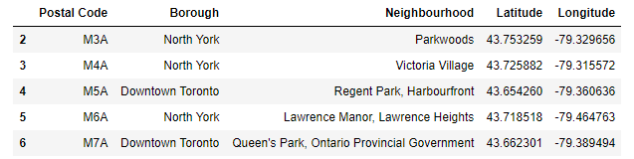
Data Collection
Toronto Data Set taking from Wikipedia, and added longitude and latitude values to it:

Slide 9
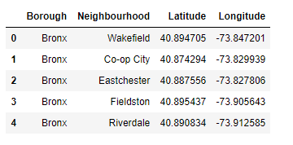
Data Collection
To get our data for New York we need to read a JSON file - https://cf-courses-data.s3.us.cloud-object-storage.appdomain.cloud/IBMDeveloperSkillsNetwork-DS0701EN-SkillsNetwork/labs/newyork_data.json. The data has all the information we need for our analysis. We will load the data and put it into a dataframe called NewYork_df.

Slide 10
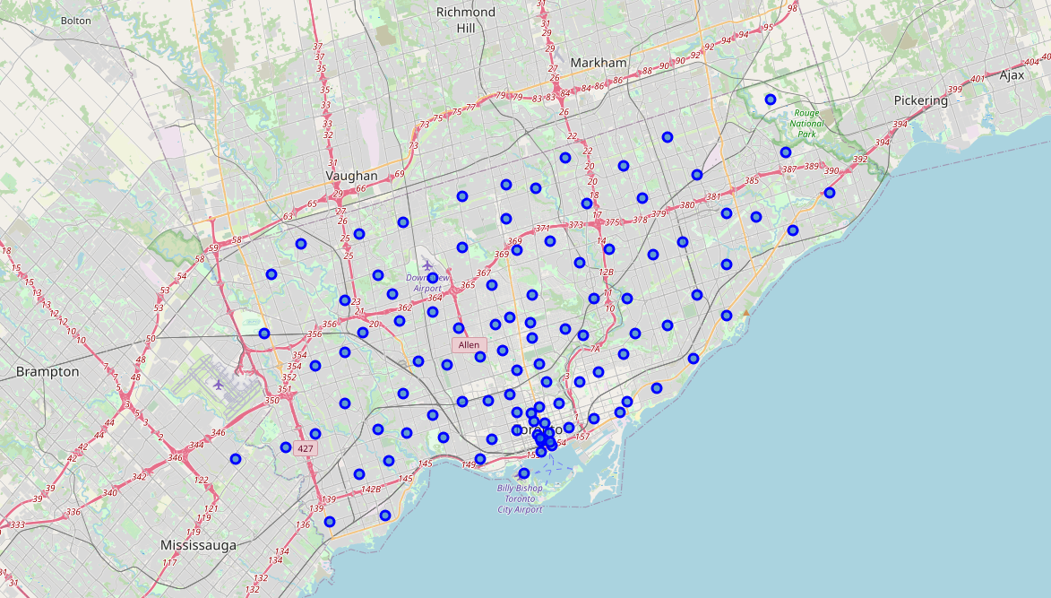
Visualization maps of Toronto and New York City
Using folium to visualize maps of Toronto and adding neighbourhoods as markers

Slide 11
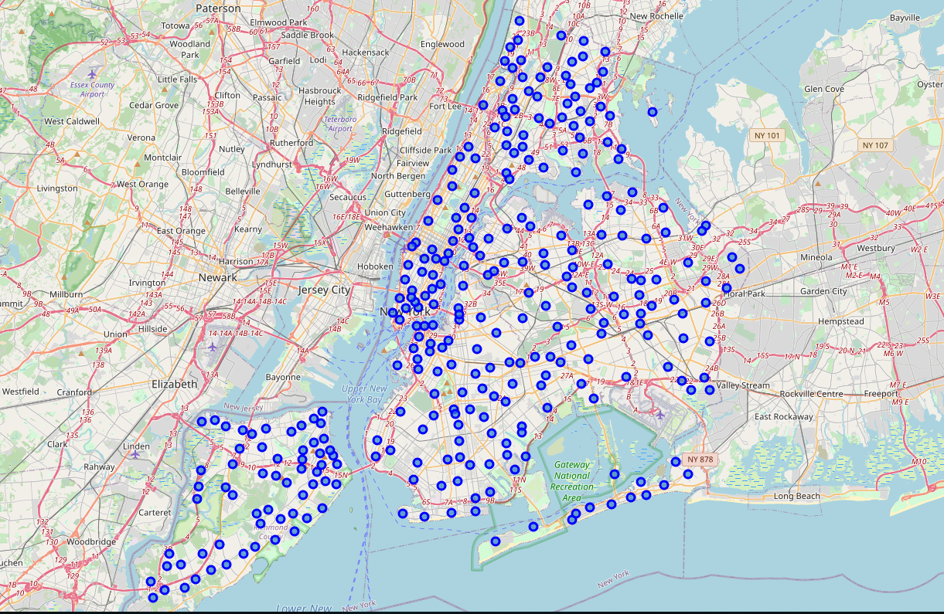
Visualization maps of Toronto and New York City
Using folium to visualize maps of New York and adding neighbourhoods as markers

Slide 12
Venues Data
We pulled in the top venues data using Foursquare API for both Toronto and New York City
We grouped our data based on Neighbourhoods and what type of venues we have
Taking the mean of the frequency of each category in the table for venues
We got our Top Ten Venues for both cities
From here we built a table showing our neighbourhoods and top venues

Slide 13
KMEANS Clustering
We will be using KMeans Clustering Machine learning algorithm to cluster similar neighbourhoods together. We will be going with the number of clusters as 5.
After getting our clusters, we added them in different colours and superimposed them on the maps for each cities.

Slide 14
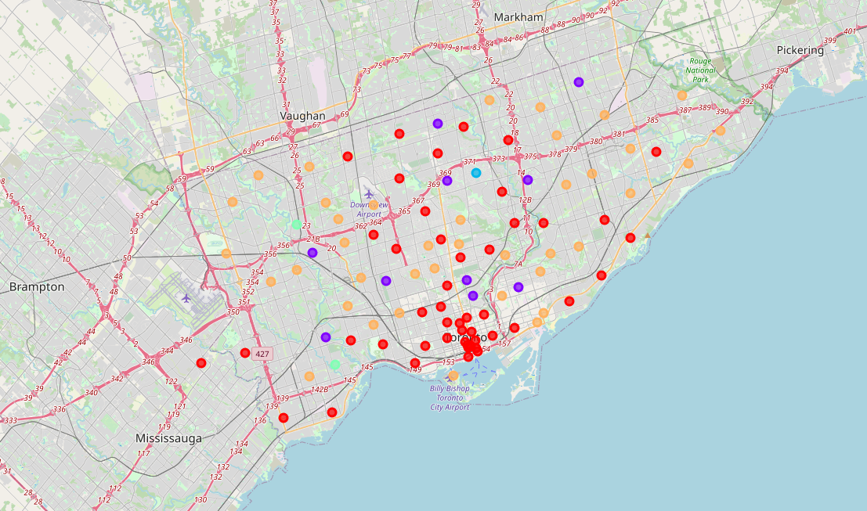
KMEANS Clustering - Toronto

Slide 15
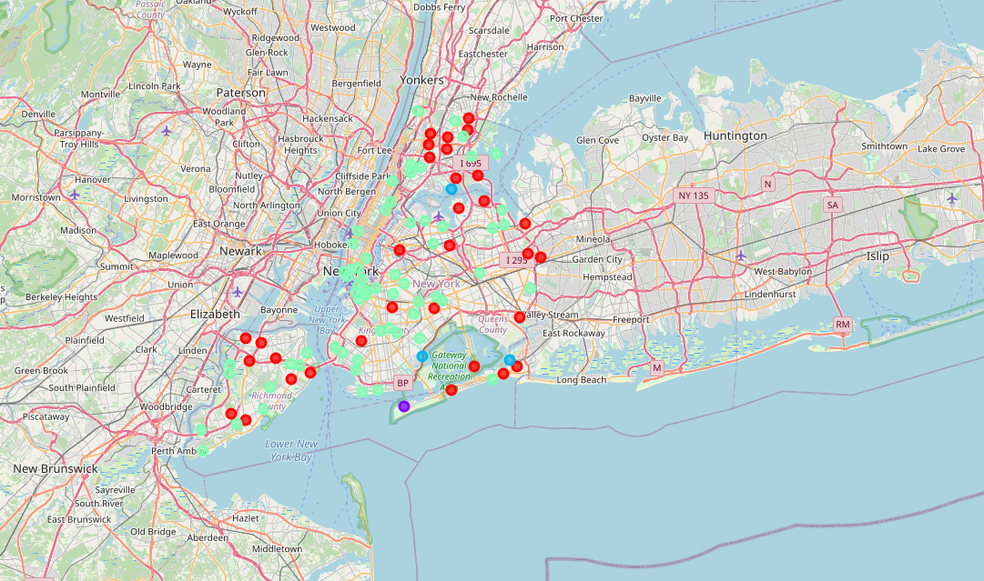
KMEANS Clustering – New York City

Slide 16
Results and Discussion
The neighbourhoods of Toronto are very diverse. There are a lot of different cafes and restaurants with various backgrounds. Toronto has a lot of cafes which suggests that it maybe better suited for young individuals. It also offers decent amount of parks and gyms as well for physical activities. It has a lot of shopping options too with that of the Flea markets, flower shops, fish markets, Fishing stores, clothing stores. The main modes of transport seem to be Buses and trains.
Overall Toronto offers a multicultural and entertaining experience.
New York doesn't offer as many cafes as Toronto but it sure offers a lot of restaurants. New York city is huge compared to Toronto and it offers a variety of parks, big and small grocery store. New York City is more suited for the individuals that are between 35 and 55 years of age. The main mode of transport seems to be buses and trains.

Slide 17
Conclusion
The purpose of this project was to explore Toronto and New York City and see what each city can offer to someone who is moving from their home and has a choice between New York City and Toronto. Although New York City offers more tourism activities, Toronto offers a well connected city with cafes, parks, gyms and various universities for education.
We could see that each of the neighbourhoods in both the cities have a wide variety of experiences to offer which is unique in it's own way. The cultural diversity is quite evident which also gives the feeling of a sense of inclusion.
Overall, both cities would be fantastic to live in and it is up to the stakeholders to decide which kind of experience would they enjoy more.

Slide 18
References
Report: https://medium.com/@oludayo.oguntoyinbo/the-battle-of-neighbourhood-my-londons-perspective-d363163771e0
Pandas Library: https://pandas.pydata.org/pandas-docs/stable/index.html
Folium Library: https://python-visualization.github.io/folium/
Geoplot Library: https://residentmario.github.io/geoplot/index.html
Foursqare API: https://developer.foursquare.com/developer/
Matplotlib Library: https://matplotlib.org/

